Slide 1
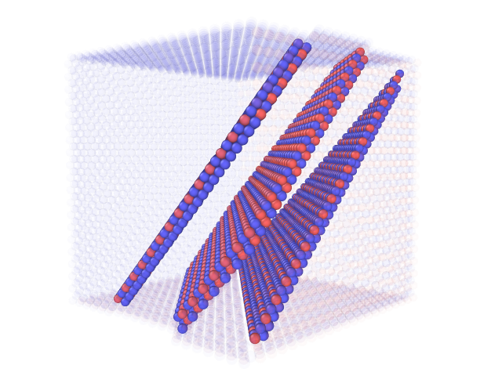
Pair Analysis
The Pair number is the number of different type of nearest neighbor for each atom (A-B).
By analyzing this simple parameter it is easy to get a first classification for the different fault type in the L1₂ system.
APB
APB
CSF
In this image the atoms with the pair number of 4 (Ni) and 12 (Fe) and general structure of FCC were deleted.

Slide 2
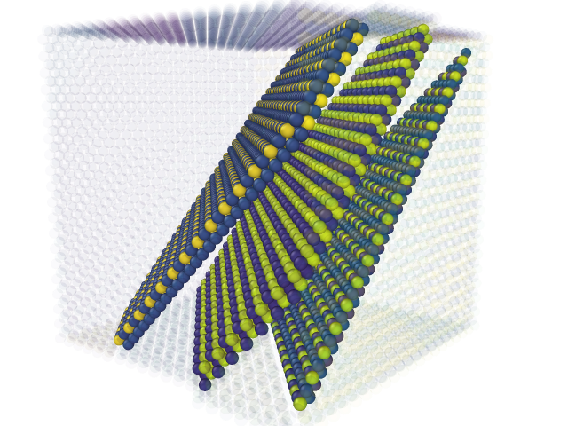
Pair Analysis
By color counting according to the pair parameter we can see that for each fault there is a different patterns
SISF
APB
CSF

Slide 3
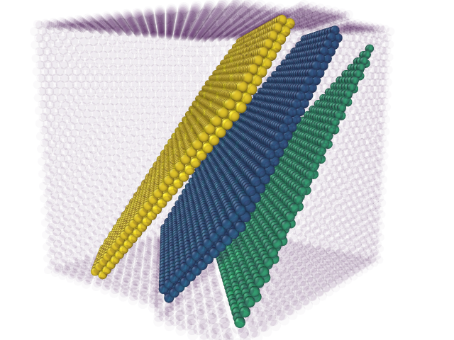
Pair Analysis
By looking on the Structure Type, the atom type, the atom pair parameter and the distribution of the pair parameter of the close neighbors we can classify the different fault in the particle.
SISF
APB
CSF

Slide 4
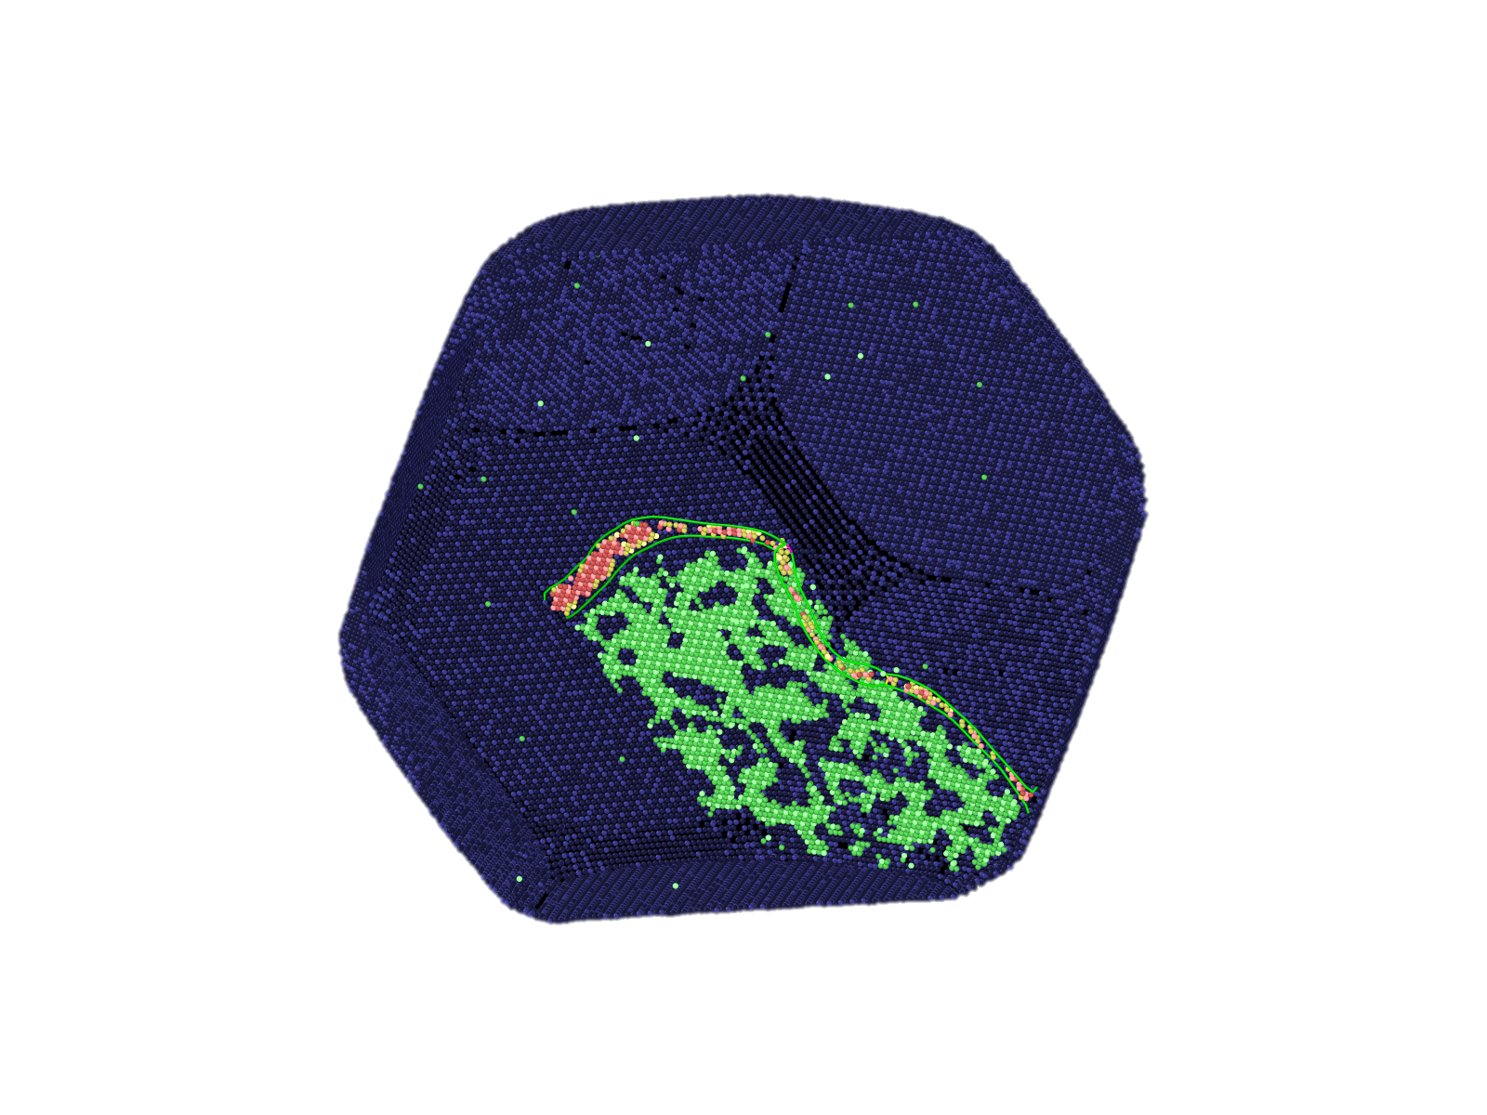
Pair Analysis
“Experimental” demonstration
Red – CSF
Green – APB
Yellow - SISF
CSF
APB

